Slide 1
CITIES EVALUATION
Photo Courtesy of: Jacob Stein-Patterson
BASELINE EVALUATION AND STATUS UPDATE
AUGUST 2018

Slide 2
CITIES Baseline Evaluation - Outline
Background and purpose
Evaluation design
Baseline findings
Final thoughts and next steps

Slide 3
Background and Purpose

Slide 4
Evaluation Timeline
CITIES RFTOP (April 2016)
  “An external quasi-experimental impact evaluation will be conducted of this program to measure improvements in municipal governance” [pg 22]
Evaluability assessment (January 2017)
  Estimating impact depended crucially on correctly identifying activity zones of influence
  Any impact evaluation should focus on validating activity inputs and contributing to a learning agenda, not achieving external validity
  In the event impact estimation not feasible, proceed with most feasibly rigorous design

Slide 5
Evaluation Timeline (cont.)
October 2017
  Subject matter expert assessments in municipal governance and decentralization
February 2018
  Evaluation Design Report approved
March – May 2018
  MICA data collection and scoring in 15 comparison municipalities, qualitative data collection

Slide 6
CITIES Timeline
CITIES Year 1 / FY17: planning, negotiating with stakeholders, initial assessments
CITIES Year 2 / FY18: continued assessments, initiation of some activities
CITIES Year 3 / FY19: continued activities, grant fund disbursements (anticipated)

Slide 7
Evaluation Baseline Purpose
A baseline evaluation report is the first assessment of an impact evaluation design against the reality of initial data collection
  Evaluation data quality
  Equivalency between treatment and comparison balance metrics
  Initial validation or failure of assumptions
  Further understanding and assessments of threats to validity of evaluation design and metrics

Slide 8
CITIES Baseline Evaluation: Objectives
Internal validity of MICA measures
  Did the evaluation team’s MICA scoring in comparison municipalities produce internally valid measures?
  If internally valid within the evaluation team, are they also internally valid (i.e. comparable) with CITIES MICA scoring?
Baseline equivalency of MICA measures
  Is there baseline equivalency between treatment and comparison municipalities?
  At what level of MICA scoring?
  What scoring areas showed the most equivalency? Which showed the most differences?
  Are some observed differences considered more of a validity threat than others?

Slide 9
CITIES Baseline Evaluation: Objectives (cont.)
Qualitative inquiry on status of municipal governance
  What is the political economy of operations and relationships within municipalities? Between municipalities and governorates? Between municipalities and line ministries?
  Are there any qualitative differences noticed between treatment and comparison municipalities?
What is the current status of CITIES implementation? What has been observed about implementation fidelity, obstacles, and lessons learned?

Slide 10
Evaluation Design

Slide 11
Evaluation Questions
What is the overall effectiveness of CITIES for achieving its goals of enhancing democratic governance, improving trust and confidence in elected officials, and strengthening stability?
Which interventions under CITIES are most likely to be sustained over time?
How well has CITIES developed synergies (coordination and collaboration) with other USAID activities that focus on similar objectives, for example, decentralization and working with Municipalities? Are donors operating in the decentralization and local governance space achieving synergies through coordination or knowledge sharing?
Based on the performance of CITIES, both in terms of effectiveness and sustainability, what are some key lessons learned, by component and sub-activity?

Slide 12
Evaluation Activities and Data Streams
Replicate CITIES municipal institutional capacity measures (MICA) in 15 comparison municipalities
National household survey for public perception of municipal responsiveness and effectiveness
Qualitative data on local governance, decentralization, donor coordination
Track CITIES implementation fidelity and activity tracking
Small scale surveys targeting CITIES grants (future activity)

Slide 13
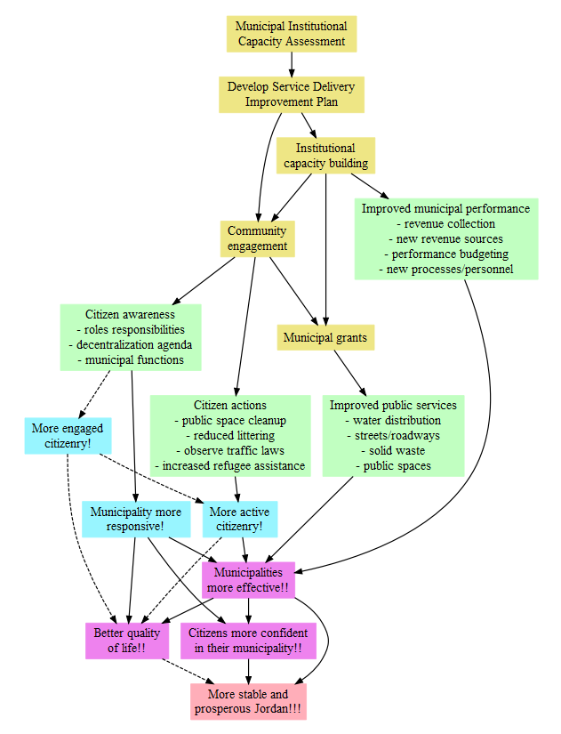
Evaluation Logic Model - Detailed Theory of Change

Slide 14
Hypothesis |  | Indicators
1 | If CITIES provides institutional capacity building, then municipal operations will improve. | MICA Services Score MICA GESI Score Municipality Revenue Budget allocation to salaries
2 | If CITIES provides institutional capacity building, combined with incentive grants and improved public service delivery, then this will lead to an improvement in the quality of public services. | Availability of services Perceived quality/availability of services
3 | If CITIES provides institutional capacity building, combined with proactive outreach by municipalities, then this will increase public perception that municipalities are responsive to citizen needs. | Perceived municipal responsiveness
4 | If CITIES supports increased attention to marginalized groups, such as youth, gender, nationality, and disability, then this will strengthen a sense of community cohesion and resilience. | Perceived municipal effectiveness
5 | If CITIES provides institutional capacity building, combined with proactive outreach and increased / improved public service delivery, then this will increase public perception that municipalities are effective. | Perceived ability to address common problems
6 | More effective public service delivery, responsiveness to citizen needs, and strengthened community cohesion and resilience will increase citizen confidence in their municipality. | Confidence in local government Trust in local government
7 | More effective public service delivery, confidence in local leadership and performance, and strengthened community cohesion and resilience will lead to a more stable and prosperous Jordan. | Quality of life Composite measures
Evaluation Hypotheses and Indicators

Slide 15
Evaluation Strategy for Inference
At the institutional / municipal level (MICA)
  Difference-in-differences (d-i-d)
  Looks only across treatment and comparison municipalities
At the citizen level (population survey)
  Difference-in-differences with spillover group
  Looks across treatment and comparison municipalities
  Also compares direct, indirect, and non-beneficiaries in treatment municipalities

Slide 16
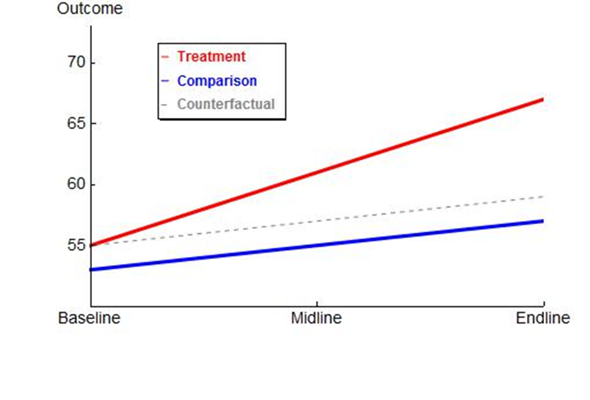
Difference in Differences (d-i-d)

Slide 17
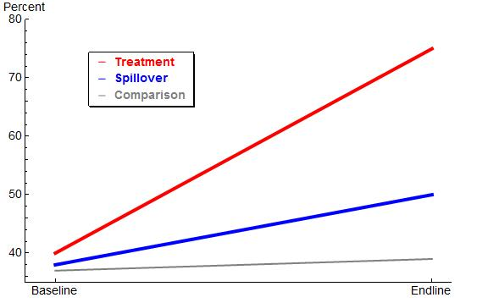
d-i-d with spillover group

Slide 18
Evaluation Strategy for Inference: Threats and Limitations
Difference-in-difference estimates rely on two crucial assumptions
  Treatment and comparison groups are equivalent prior to treatment
    Was treatment randomly assigned?
    If not, what selection effects were present during municipality selection?
  Treatment and comparison groups would have equivalent responses to treatment
    Could selection effects, in addition to creating differences between groups pre-treatment, indicate that the groups would have their own unique responses to the treatment?

Slide 19
Evaluation Strategy for Inference: Threats and Limitations
Do we control for other USAID activities, other donor programming, GOJ programming?
How does CITIES fit into the GOJ decentralization initiative?
Validity of municipal institutional assessment measures (MICA) for purposes of impact evaluation an open question
CITIES programming began in some municipalities prior to baseline measures – is this reconcilable?
Some time elapsed between treatment MICA scoring and comparison MICA scoring – is this reconcilable?

Slide 20
Evaluation Strategy for Inference: Mitigation Strategies
Propensity score matching to redress the lack of randomization
Qualitative inquiry to understand context dynamics
  Key informant interviews, relationship building, and relationship management
Tracking contextual data where available
  Government data, other donor presence and investments, decentralization progress
Tracking CITIES activities
Learning agenda
  Triangulate multiple data sources to address broad questions about the implementation environment or differential treatment effects

Slide 21
Baseline Findings
Findings from MICA scoring in 15 comparison municipalities
Internal validity of MICA scoring
Baseline equivalency across treatment and comparison MICA scores
Other evaluation questions
Status of CITIES implementation and activity tracking

Slide 22
MICA Scoring and Supplementary Inquiry
Respondent Category | Total KIIs
Mayors | 4
Municipal Council Members | 2
Local Council Members | 2
Governorate Council Members | 2
Executive Council Members | 2
CBOs | 2
MoMA Officials | 3
Donors | 5
Total | 22
Data collection
MICA interviews in 15 comparison municipalities
22 supplementary KIIs to inform understanding of macro environment

Slide 23
Evaluation Question 1: Effectiveness
Themes:
Municipal Services and Control
Community Engagement within Municipalities
Role of Local Councils
Role of Governorate Councils
Perceptions of Decentralization

Slide 24
Evaluation Question 1: Effectiveness
Municipal Services and Control
Dysfunctional financial system
Limited autonomy
Weak institutional capacity and staffing challenges
Expanding responsibilities and financial liabilities

Slide 25
Evaluation Question 1: Effectiveness
Community Engagement
Engagement Channels
  Direct contact
  Social media
  Local councils
  Needs guide preparation process
Limitations
  Lack of systematic feedback or use of citizens input for planning
  Fear of raising expectations

Slide 26
Evaluation Question 1: Effectiveness
Local Councils
Unclear mandate and lack of resources
Friction with municipal staff
Governorate Councils
Limited mandate
Limited devolution of power
Lack of regulations
Unsystematic interaction with municipal units
Concern about community engagement

Slide 27
Evaluation Question 1: Effectiveness
Perceptions of Decentralization
Promising initiative but will take time to take root
Assigned responsibilities to inexperienced actors
Centralized decision-making is still operative
Weak engagement and linkages between layers
Heightened citizens’ expectations
May have adversely affected local government’s ability to address communal needs
Need to activate municipalities’ developmental role
Exposed gaps in legal framework

Slide 28
MICA Scoring Process
Data collection in 15 comparison municipalities (Feb-April)
  3 enumerators, independent notes and scores
Facilitated enumerator scoring review
  Rationale behind scores
  Review of observations and notes
  Review and discussion of scoring rubric challenges and interpretations
    Any decisions on scoring practices reached by consensus
    Scoring logic applied to other municipalities
  Formulated final unified score for each MICA element in each municipality
Reviewed scoring evaluation team scoring logic and any issue areas with CITIES Component 1 Leader

Slide 29
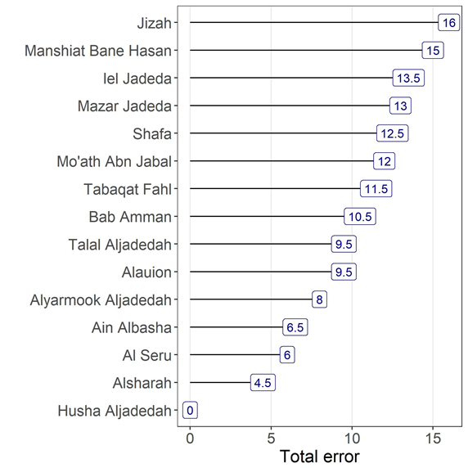
Total Inter-rater Error, by municipality

Slide 30
Most Inter-rater Error, by MICA Item
Item | Measure | Total Error
4.3 | Waste Management | 18.5
1.2 | Records, Permitting, Licensing | 13
4.7 | Transportation | 13
7.2 | Disaster Management | 13
3.1 | Urban Planning | 11
3.4 | Building Licensing | 10

Slide 31
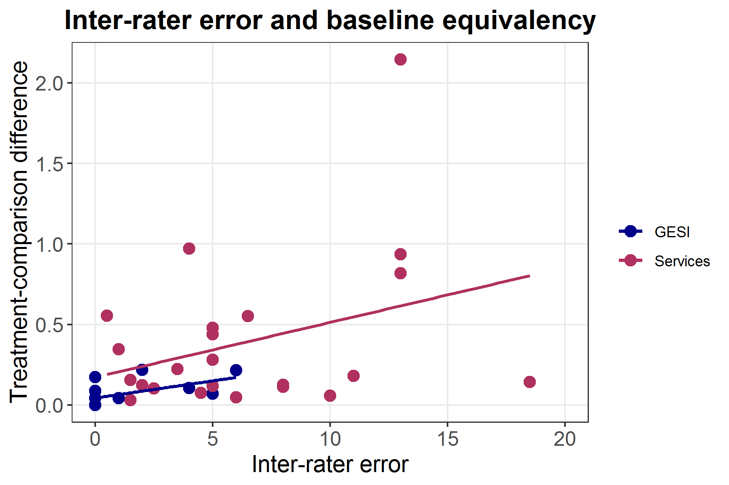
Higher inter-rater error leads to larger differences between treatment and comparison
Scoring review with CITIES Component 1 addresses methodological discrepancies

Slide 32
Inter-rater agreement statistics
Municipality | Percent Agreement | Weighted Kappa Score
Alsharah | 71 | 0.97
Al Seru | 71 | 0.98
Talal Aljadedah | 70 | 0.65
Mo’ath Abn Jabal | 67 | 0.97
Bab Amman | 67 | 0.63
Ain Albasha | 67 | 0.98
Alauion | 65 | 0.95
Manshiat Bane Hasan | 64 | 0.64
Iel Jadeda | 61 | 0.94
Tabaqat Fahl | 60 | 0.96
Alyarmook Aljadedah | 60 | 0.98
Shafa | 57 | 0.57
Jizah | 56 | 0.95
Mazar Jadeda | 56 | 0.97

Slide 33
Internal Validity of Evaluation Team MICA Scores: Conclusion
Comparison MICA scores are internally valid among MESP raters and with CITIES scorers
  A low to moderate correlation between inter-rater error and differences across treatment and comparison highlights the risk that inter-rater error can pose to impact estimates
  Despite some concerns about a few items and municipalities, measures generally appear to have sufficient agreement between raters

Slide 34
Baseline Equivalency of MICA Measures: Aggregated
Category (Treatment / Comparison) | Component | Treatment Mean | Comparison Mean | Difference | Standardized difference
Selected municipalities (15/15) | Services | 22.6 | 21 | 1.6 | 0.25
Excluding class A (15/23) | Services | 21.1 | 21 | 0.1 | 0.02
All CITIES municipalities (15/33) | Services | 27.6 | 21 | 6.6 | 0.70
Selected municipalities (15/15) | GESI | 1.53 | 0.53 | 1 | 0.98
Excluding class A (15/23) | GESI | 1.52 | 0.533 | 0.99 | 0.91
All CITIES municipalities (15/33) | GESI | 1.8 | 0.53 | 1.27 | 0.96

Slide 35
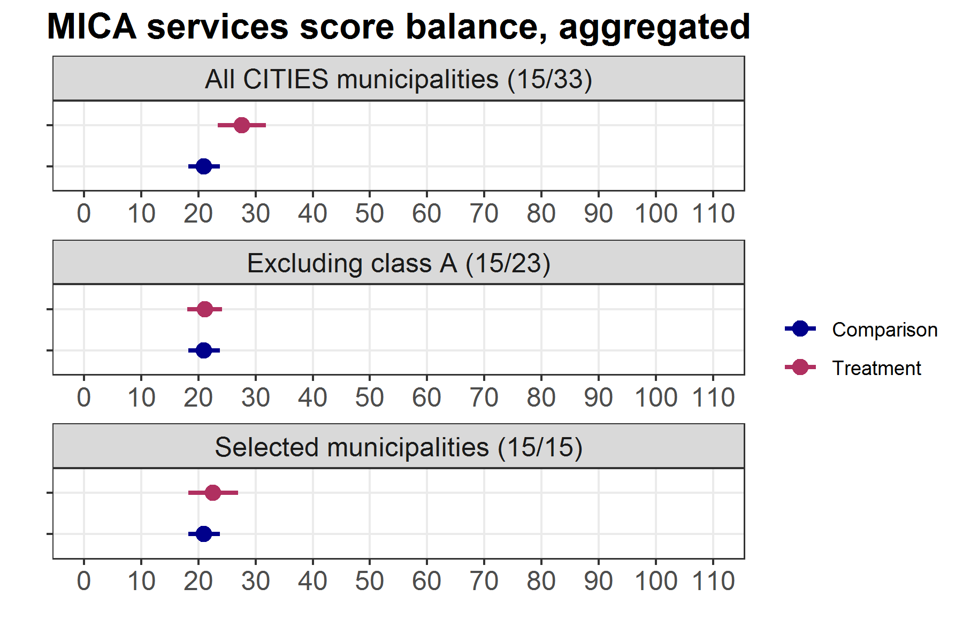

Slide 36
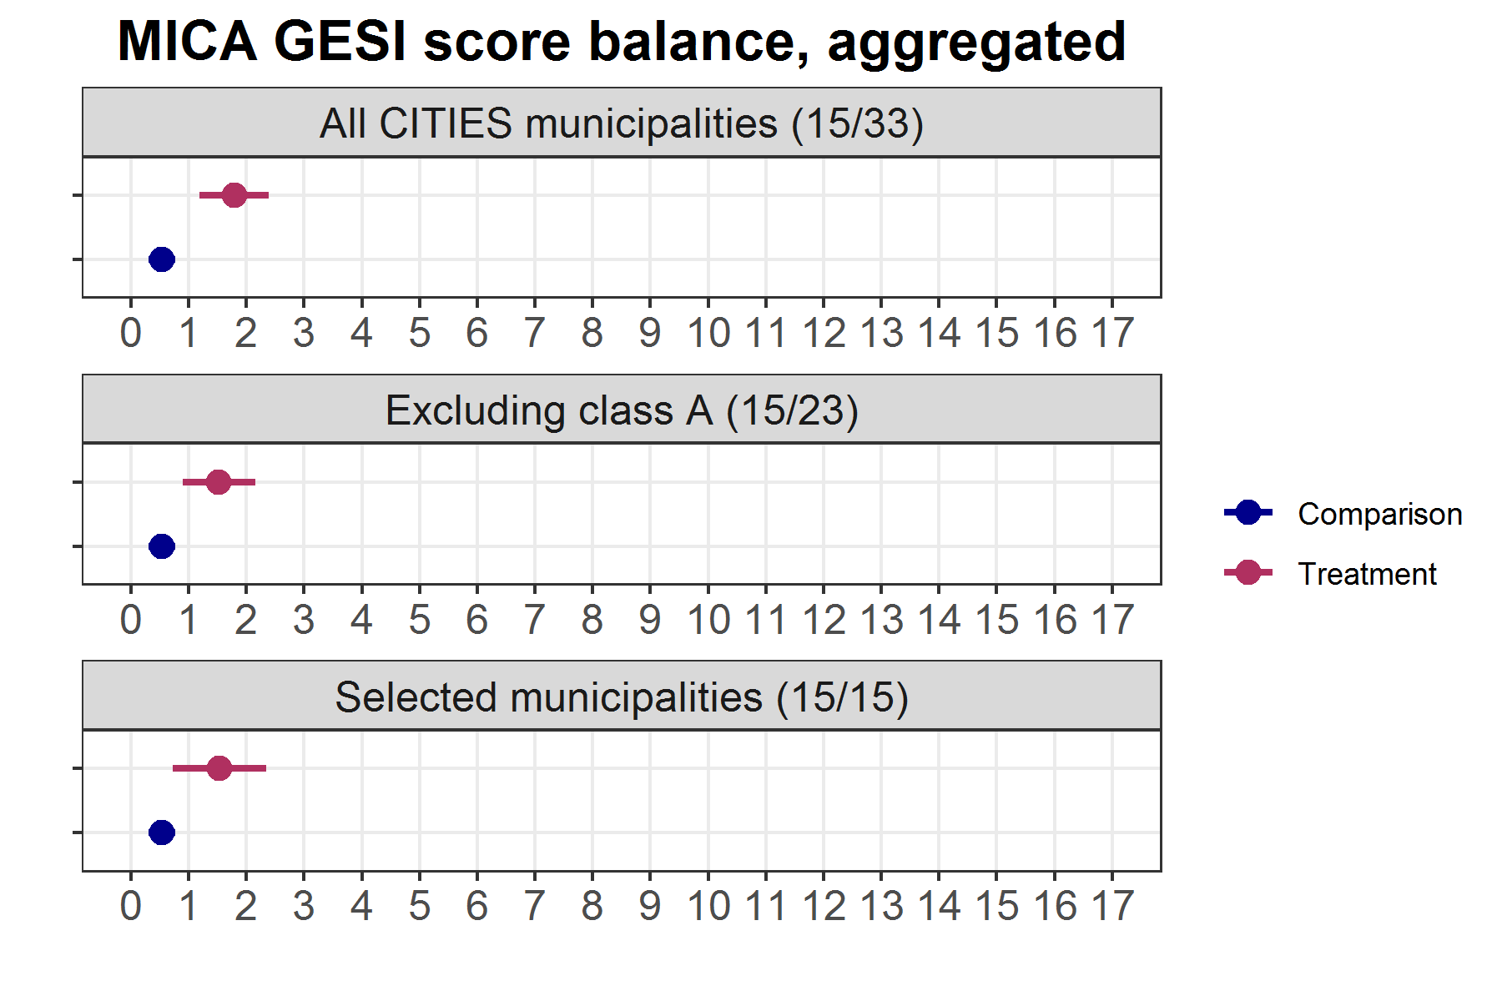

Slide 37
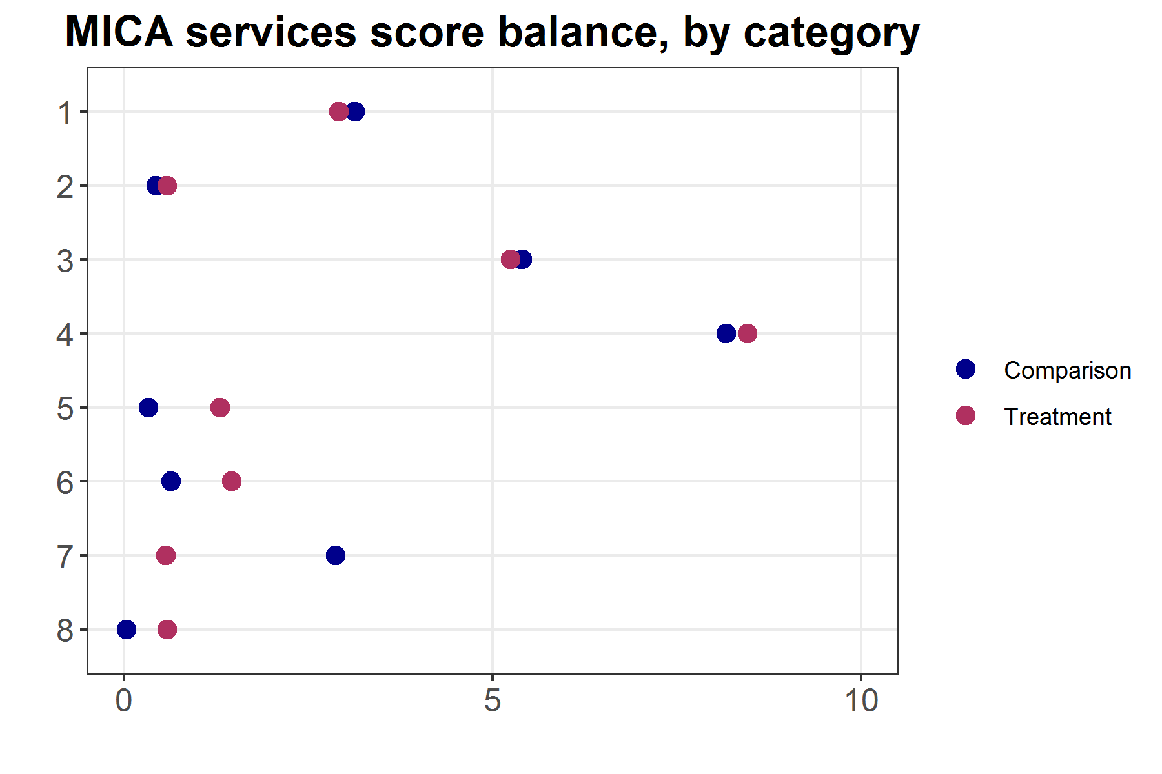
MICA Services Element Group

Slide 38
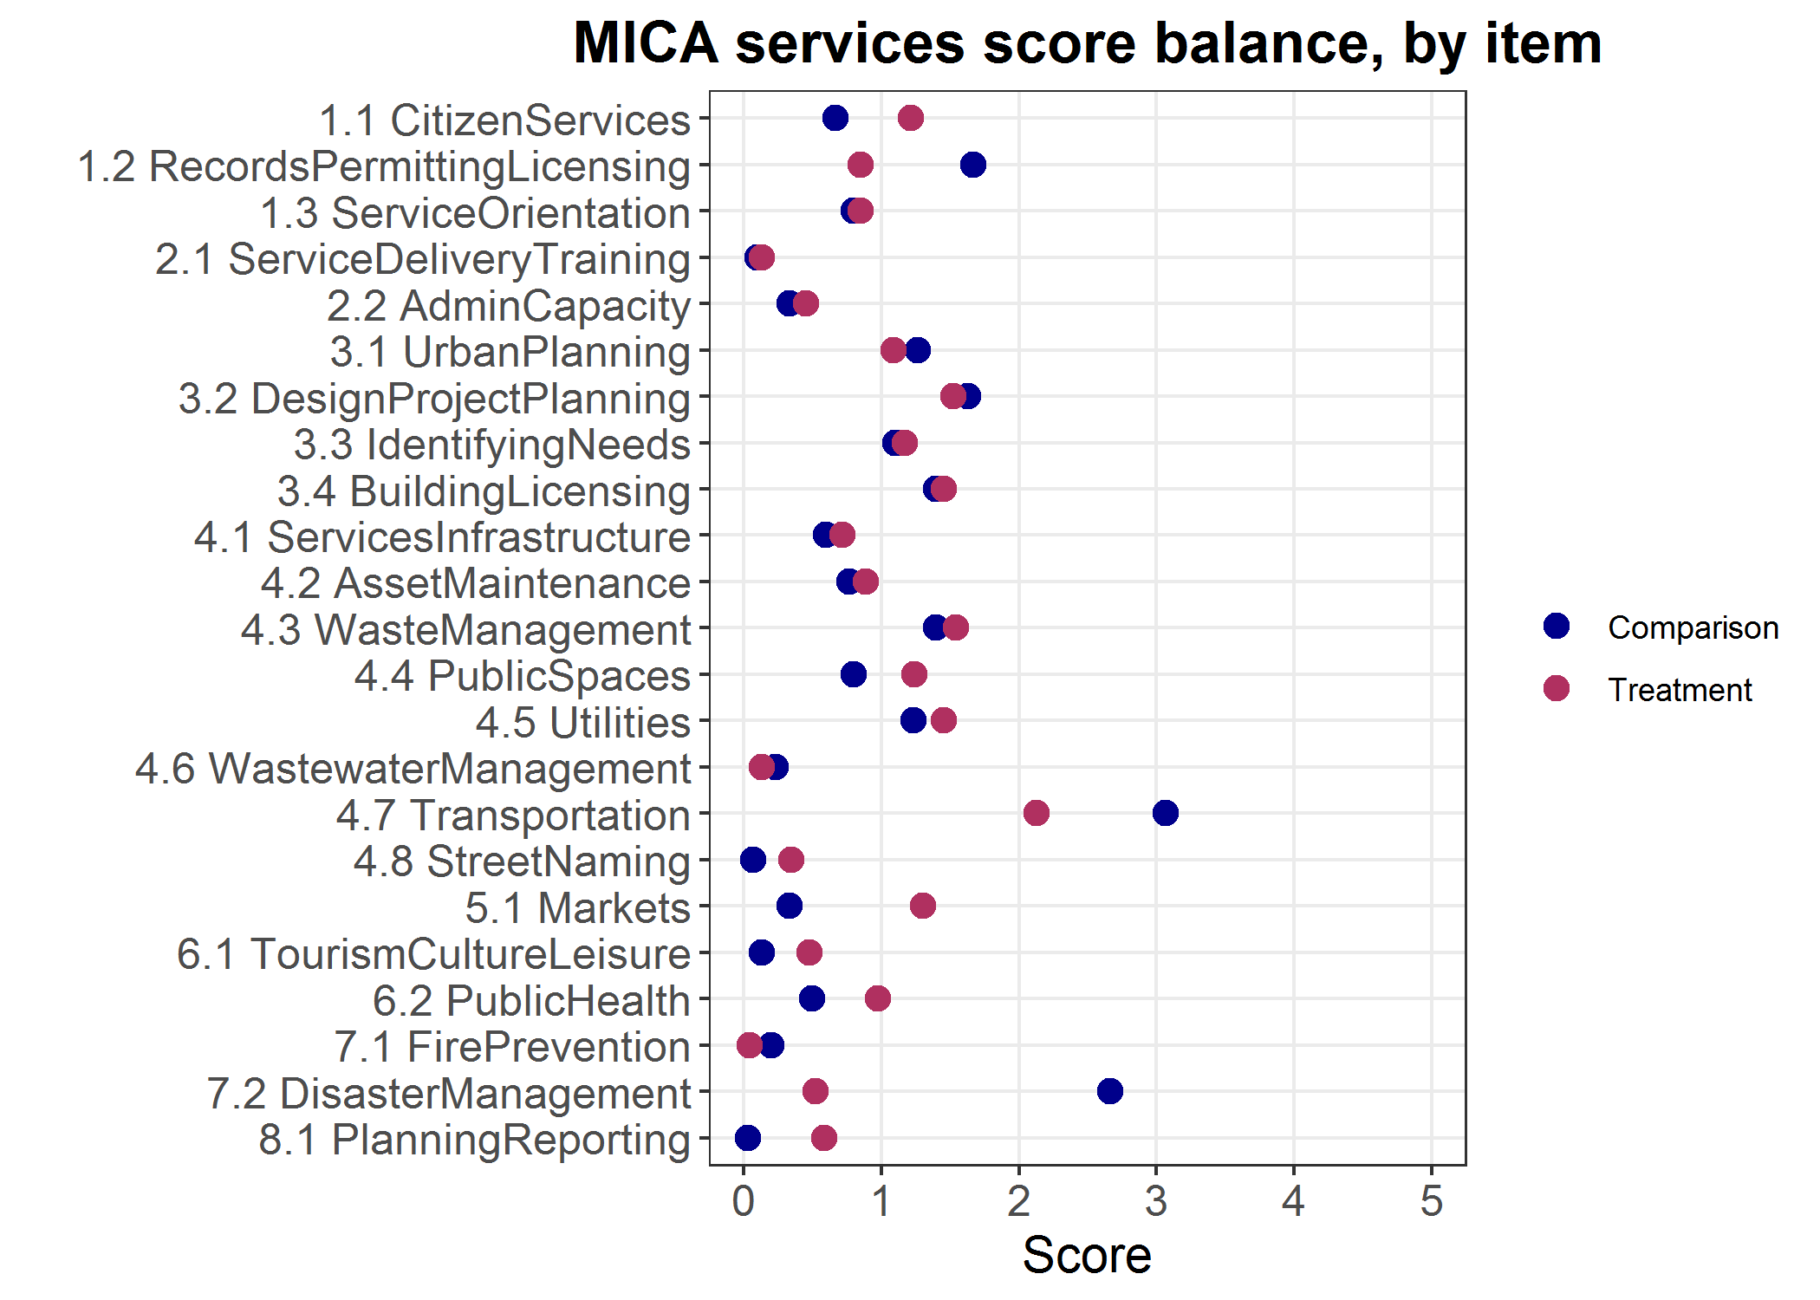

Slide 39
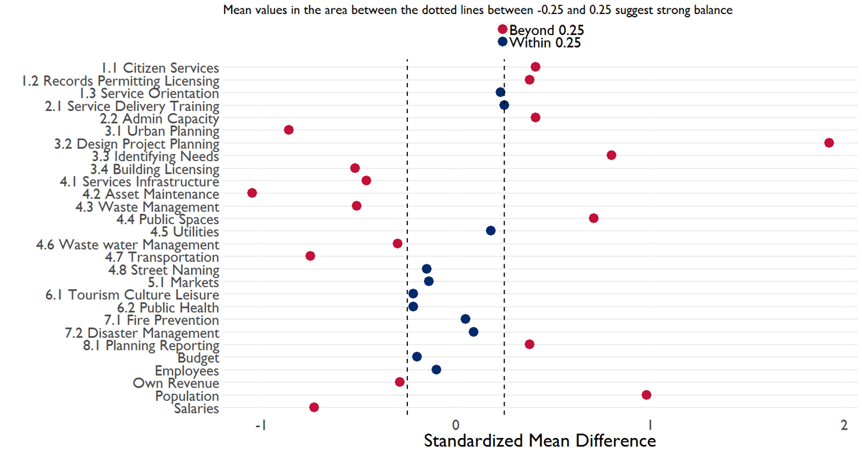
Standardized Differences by Assessment Item – MICA Services

Slide 40
Baseline Equivalency Across Treatment and Comparison: Conclusions
There is baseline equivalency across treatment and comparison municipalities
  Despite some concerns about a few items and a few municipalities, in aggregate (scores aggregated to municipality or within scoring categories within municipalities) there appears to be baseline equivalency between treatment and comparison measures
  Due to a higher degree of item-level variability, inference at the level of individual scoring items will require triangulation with other data streams

Slide 41
Evaluation Question 2: Sustainability
Findings from supplementary qualitative data collection
System-level changes/initiatives endorsed by national government
Capacity and will of MOMA and municipalities to assume and exercise ownership of program facilitated reforms
Harmonized donor support for capacity development
Civil society capable and empowered to monitor continued implementation of reforms and overall municipal performance
Technical knowledge vs. awareness raising type of capacity building

Slide 42
Evaluation Question 2: Sustainability
Overall risks to sustainability
  GOJ slow implementation of reforms or devolution of power needed for municipalities to assume new responsibilities
  Slow or inadequate provision of financial resources to municipalities or governorates
  Serious municipal capacity constraints to sustain intervention benefits
  Lack of incentives and weak motivation deter municipal staff participation and the adoption of corrective actions
  Duplicative and unharmonized donor programming lead to municipal staff adopting different procedures and processes to undertake same tasks
  Skewed public perception of municipal services affects program impact

Slide 43
Evaluation Question 3: Synergy
Findings from supplementary inquiry and donor tracking
28 implementing agencies operating through 48 projects that translate into 208 separate interventions at both the central and local levels and in the following areas:
  Policy, Legislation and Regulation
  Functional Assignment
  Institutional and Organizational Structures
  Inter-Governmental (Institutional)
  Systems, Procedures and Manuals
  Capacity Development
  Local Public Finance

Slide 44
Evaluation Question 3: Synergy
Various donors implementing direct and indirect capacity building interventions
A clear roadmap for envisioned change is still lacking
Need for joint approach to maximize impact of programming
Coordination lead by GOJ is more about communicating activities than working out division of donor efforts or synergies
Weak horizontal coordination and linkages between MOMA staff overseeing projects
Close coordination by CITIES with WB, OECD, VNG, AECID, and AFD

Slide 45
Evaluation Question 4: Learning
Information to track to inform understanding of context:
Changes in legislative and regulatory framework
Regulatory, relational and technical dimensions of the various municipal functions.
Relational dynamics between municipal leadership staff
Automation process in municipalities
GOJ decision-making regarding resource allocation to municipalities and governorates
Overall direction of decentralization
Donor activities and lessons learned
Traction on GoJ Local Governance Training Institute and the National Strategy of Decentralization

Slide 46
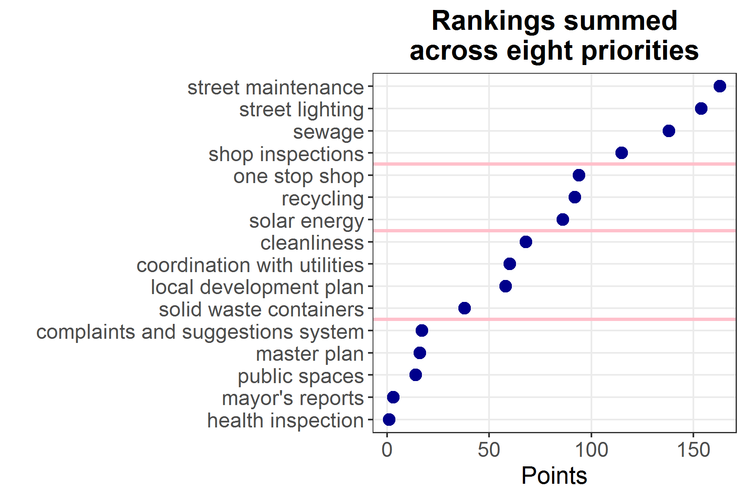
Component 1 Priorities

Slide 47
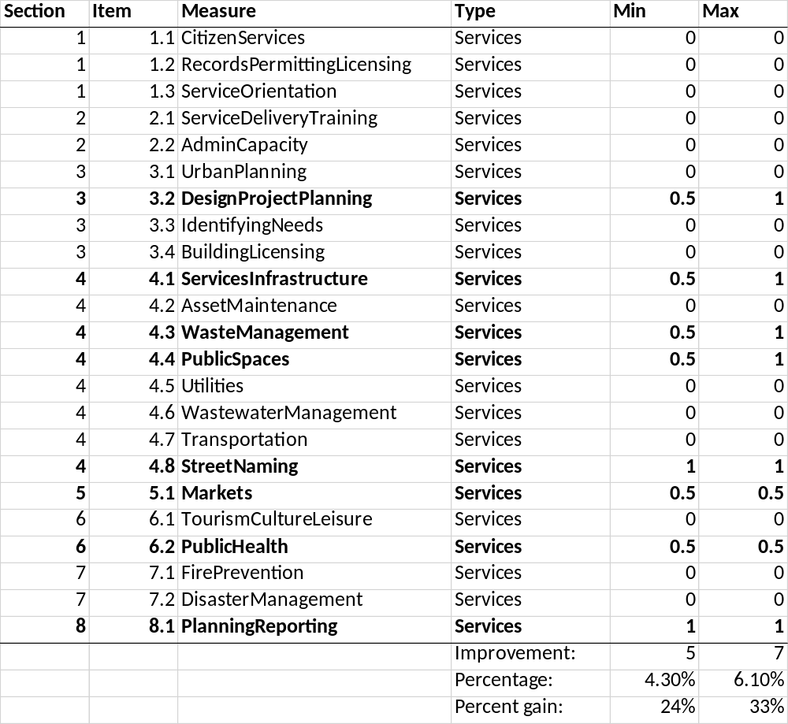
Tentative Projections of MICA Score Gains
For discussion purposes only –
NOT official targets
(Source: Component 1 Lead discussion)

Slide 48
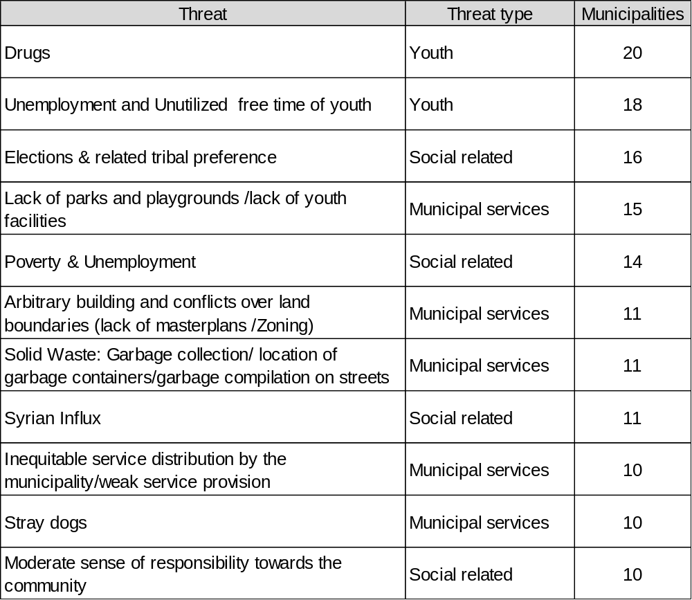
Threats to cohesion

Slide 49
Opportunities to Evaluate CITIES Grants
Grants in several sectors would not be expected to translate to improved public perception
Opportunities to examine grants in relation to both institutional capacity and public perception include:
  Street maintenance, cleanliness, lighting
  Solid waste
  Public parks

Slide 50
Final Thoughts and Next Steps
Pending baseline analyses
Future evaluation activities

Slide 51
Pending Baseline Analyses to be Completed:
Household Survey
Household survey of n=12,000 launched in July, expected completion by September
Originally motivated by desire to measure CITIES indicators on public perception, but also serves as a measurement and assessment tool for other mission indicators and activities as relevant
  Analysis plan includes a learning agenda to pursue contextual questions around CITIES and other mission activities
Analysis will extract CITIES-related indicators across a selection of treatment and comparison indicators
  Analysis will examine baseline indicator levels as well as any differences between treatment and comparison municipalities
Timeline for completion: Sep-Oct

Slide 52
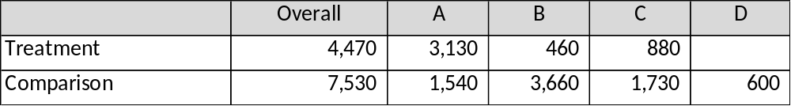
Household Survey: Sampling
16 CITIES, 39 comparison municipalities
10 of the comparison municipalities have MICA (n=1,600)
CITIES data mostly Class A municipalities
What to measure?
Mission indicators
Learning Agenda questions
The ‘funnel of attribution’

Slide 53
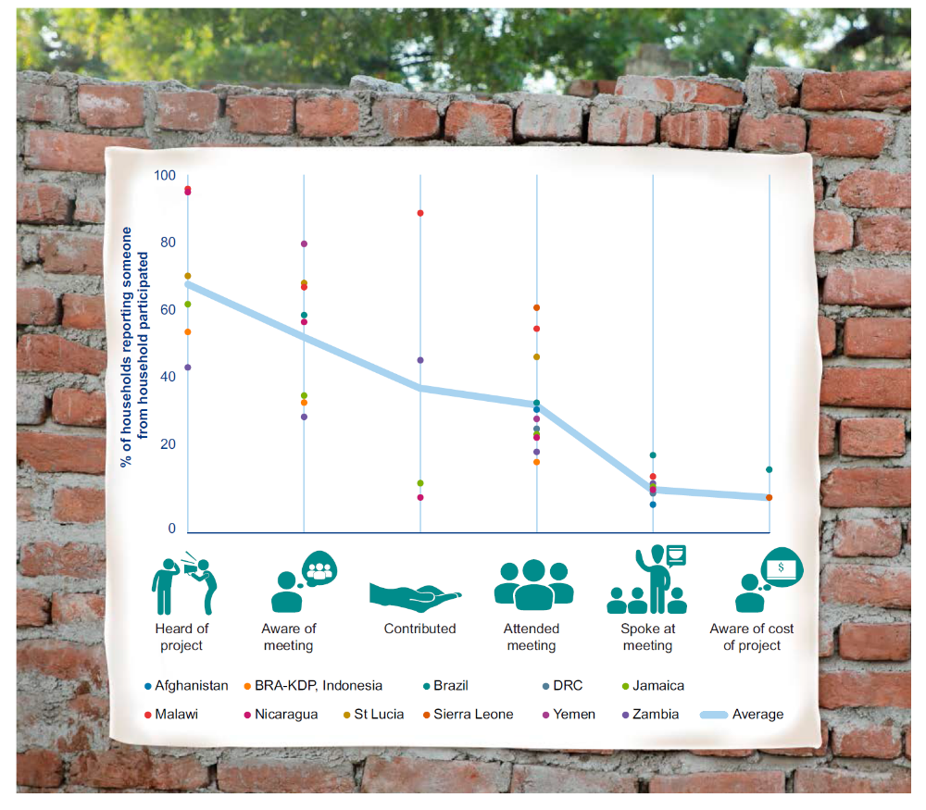
The ‘funnel of attribution’ will be used to discriminate between direct, indirect, and non-beneficiaries within CITIES municipalities
Source:
Community Driven Development: Does it build social cohesion or infrastructure?
3ie Working Paper #30
White, Menon, Waddington

Slide 54
Future Evaluation Activities for USAID Consideration
FY 2018 Q4: next round of implementation fidelity monitoring
FY 2019: small scale surveys targeting grant activities
FY 2020 Q1: Midline evaluation covering CITIES Years 1-3
  Most significant change / Appreciative inquiry
  Investigate Learning Agenda questions
  Evaluate the implementation of CITIES Year 3 activities and grants
FY 2021 Q1: Endline evaluation activities
  MICA scoring
  Endline household survey
  Investigate Learning Agenda questions

Slide 55
THANK YOU!

